Slide 1
SIS Analytics Challenge
Keegan Abdoo
Mehmet Erden

Slide 2
Method
Exploratory Analysis + Feature Engineering
Determine which defensive actions have a statistically significant effect on the outcome of plays (measured by EPA)
Assign an EPA value for these defensive actions using linear regression
Determine the most valuable defensive technique instead of using broader definitions (ex. Edge vs IDL) since DL techniques on each play is arguably the most valuable information presented in this data set that is not available publicly
Look at talent distributions across the positions and how value differs for different situations

Slide 3
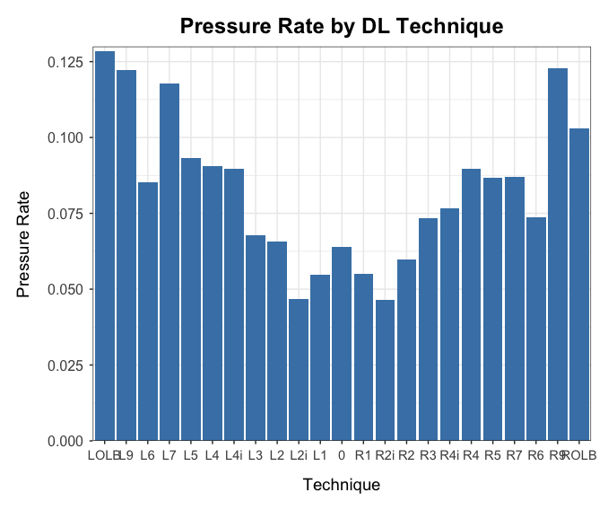
Exploratory Analysis Pressure Rates Increase as Players line up wider

Slide 4
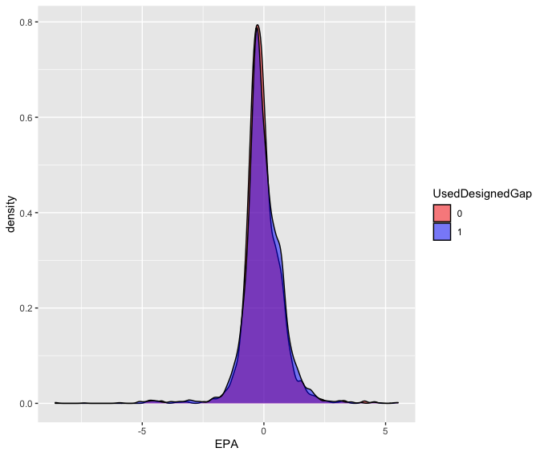
Exploratory Analysis There is no significant difference in the distribution of EPA if runs don’t go in the designed Gap

Slide 5
Feature Engineering
Removed Spikes and Scrambles (Scramble plays had NA values for features associated with passing plays such as pressures and we did not want to include scramble plays as designed runs)
in_designed_gap variable: Indicates if there was a defender in the gap the run was designed to go
dl_tackle: Indicates whether a player lined up as a DL made a tackle on the play
pressure_type: Indicates the type of pressure (edge, interior, both or other) on the play
OLB, 9, 7, 6 and 5 technique were defined as Edge. Off-ball was not included in both categories

Slide 6
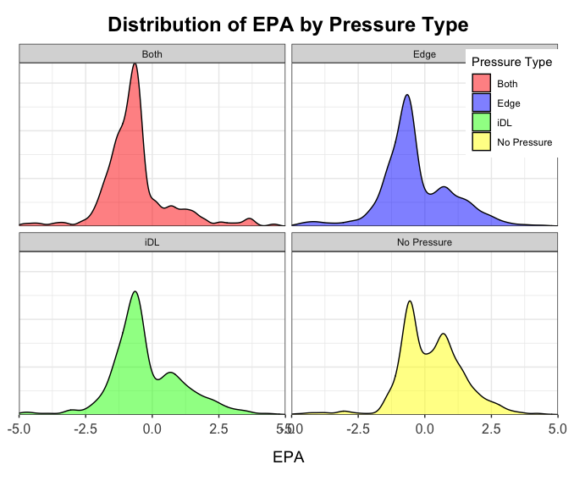
Defensive Actions Pressure
Pressures were found to be more indicative of pass rush skill and more consistent from season to season (Eager, 2018)
Significantly effects outcome of plays.
We found no statistically significant difference in the EPA mean or distribution of interior vs edge pressures (Independent Samples t-test and Kolmogorov-Smirnov test)

Slide 7
Defensive Actions Sacks, Fumbles, Pass Breakups
Although sacks are more impactful than pressures they were not included.
Recent research indicates turning pressures into sacks are random and cannot be consistently repeated (Riske, 2020)
Therefore, including sacks in a 9-week sample would be reflective of random outcomes rather than true skill
We also assumed sample size is not enough to reflect fumble skill (if there is such a thing)
Pass breakups were included as they have a significant impact on play outcomes and occur twice as often as sacks, creating sufficient sample size across positions

Slide 8
Defensive Actions Gap Forces
If a defender is in the designed run gap and the run does not go in that gap, the defender is credited with the Gap Force
Assumption: The defender/s in the gap are the sole reason the run is forced away from its designed gap.
We found no statistically significant effect of Gap Forces on run plays (t-test and KS test)

Slide 9
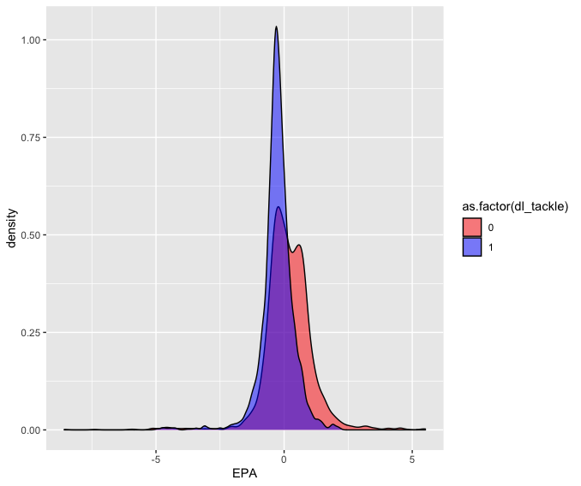
Defensive Actions DL Tackles
We found no significant effect of DL Tackles on pass plays (excluding TDs)
There is a significant difference in the outcomes of run plays with a DL tackle vs. ones without (excluding TDs)

Slide 10
Linear Models
Two linear models were fit, one for passing plays and the other for run plays with EPA as the dependent variable.
Both models controlled for TDs, Down & Distance and Yard Line
Coefficients were used to assign dEPA (defensive EPA) value for Pressures, Pass Breakups on Pass Plays and DL Tackles on Run Plays.
Although all variables were statistically significant, R-squared values for both models were low as expected due to the absence of more variables (eg. Time to throw, air yards etc.)

Slide 11
dEPA Values:
Pass Plays
Pressure = .609 dEPA
Pass Breakup = 1.527 dEPA
Run Plays
DL Tackle = .340 dEPA

Slide 12
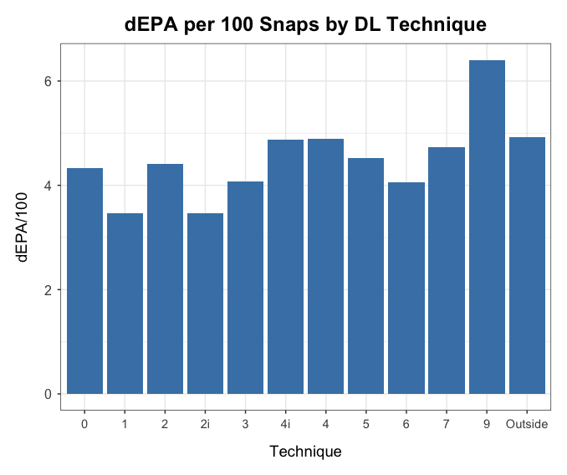
Most Valuable DL Position
We conclude that the 9-technique position is the most value generating position across the DL.

Slide 13
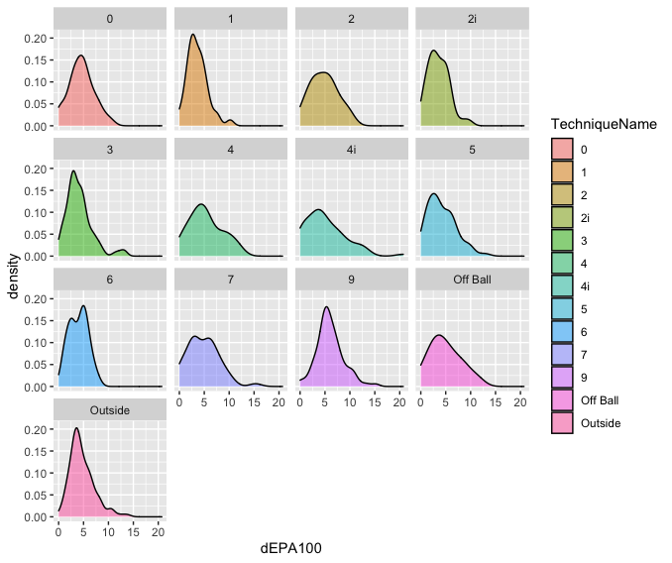
Talent Distributions
Defenders aligned directly across Offensive Linemen (2-Tech, 4-Tech, 7-Tech, not including NG/0-Tech) generally had flatter dEPA distributions than players aligned in a shade

Slide 14
Limitations and Further Points
Due to lack of other data, each defensive action created the same value. However, for example, not all pressures are the same. Other variables such as Time to Throw would allow to address this.
Due to limited sample size, we did not differentiate techniques by the side of the ball. Left Side players, especially on the edge, created more value in this sample. While this supports the claim that offenses play their best tackle on the left and defenses play their best rusher over the right tackle, we could not conclude for certain if this was the case due to sample size and missing data on offensive players.

Slide 15
References
Eager, 2018 https://www.pff.com/news/pro-just-how-important-are-sacks-for-a-defense
Riske, 2020 https://www.pff.com/news/nfl-pff-data-study-sack-artist-pass-rushers

